Slide 1


Life insurance risk classification
Prepared by:
Natasha Rana
CDF(Batch July 2020)

Slide 2
Introduction
Life insurance companies provide life insurance to their customers by calculating and assigning a risk class to each individual.
Once the risk class is identified by the company, it quotes the actual cost of the policy and premium amount that is to be paid by the policyholder at regular intervals.

Slide 3
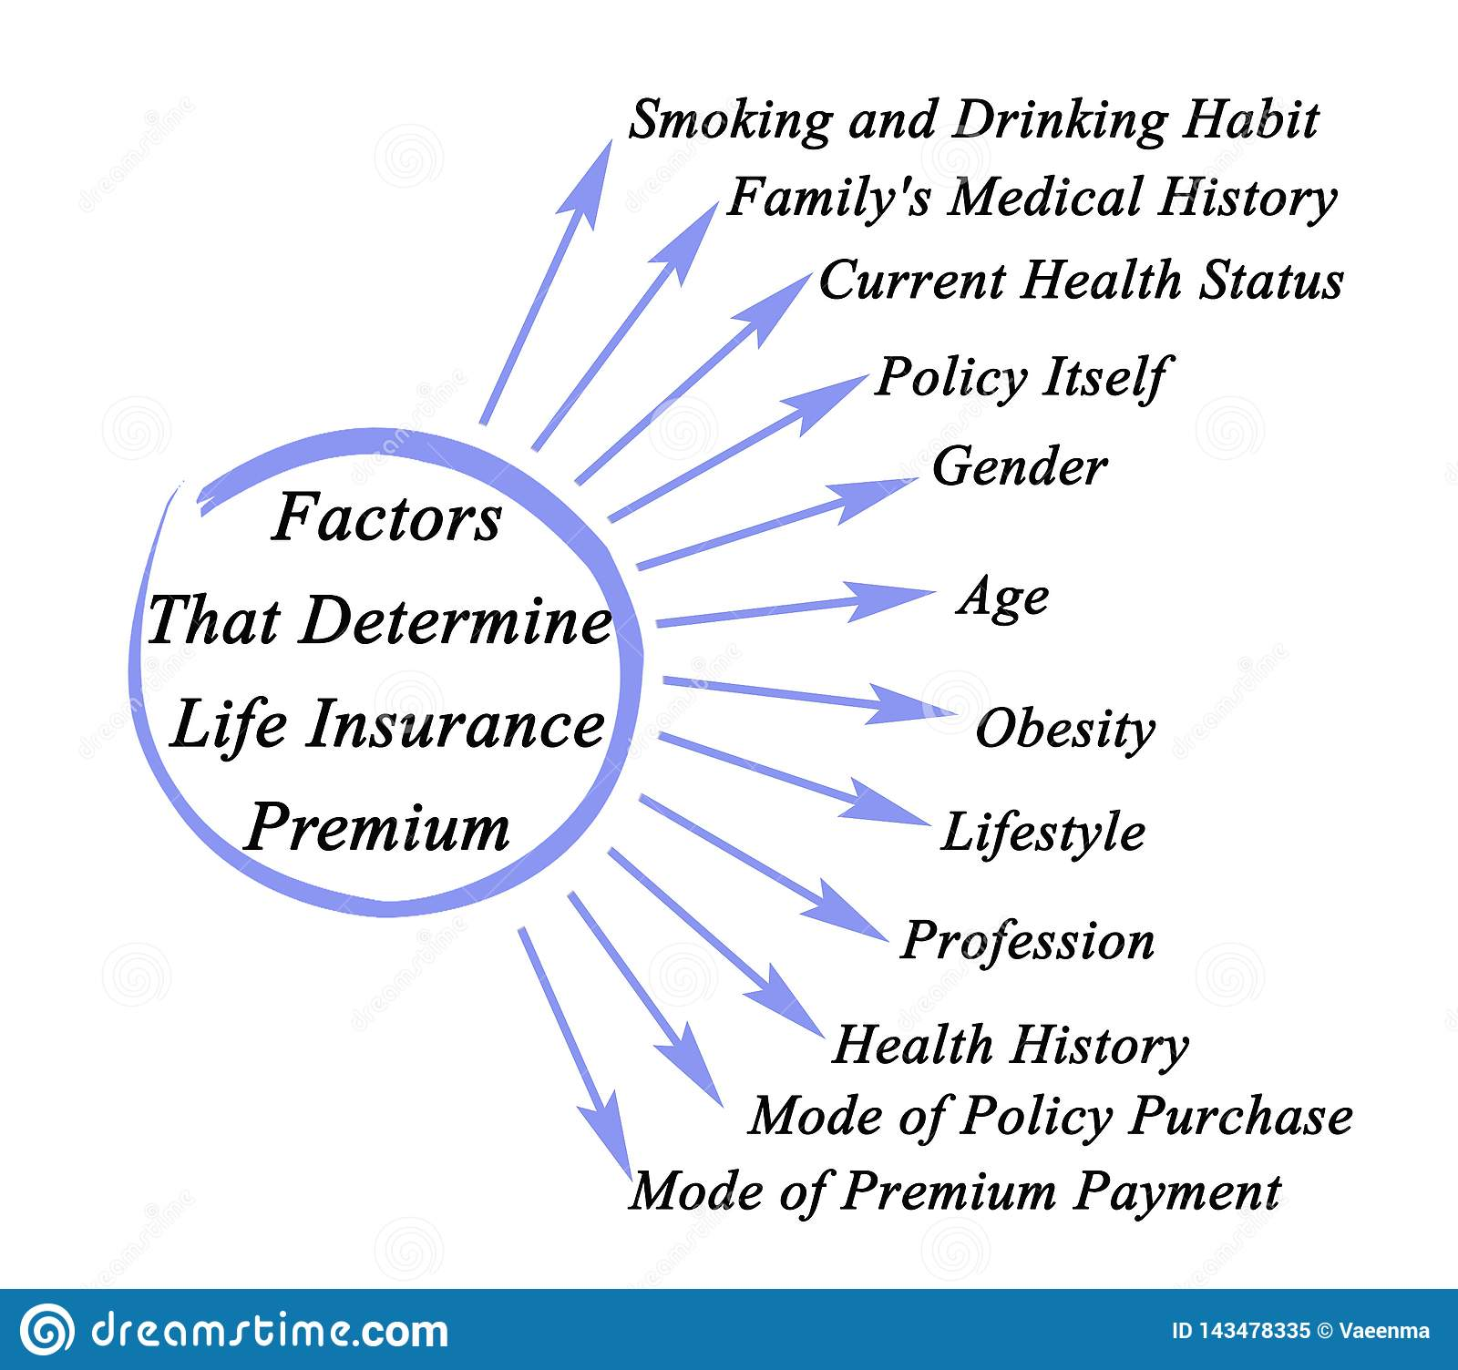

Slide 4
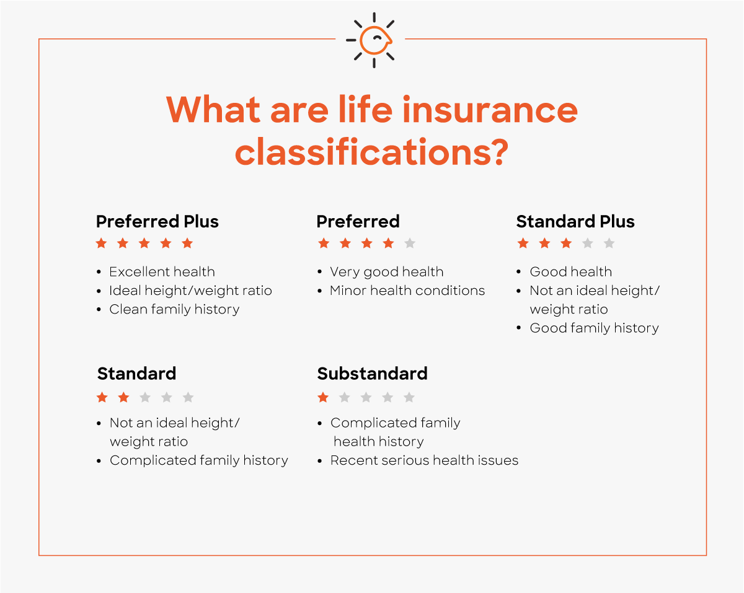

Slide 5
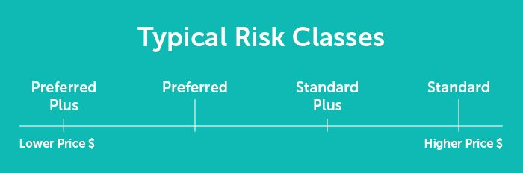
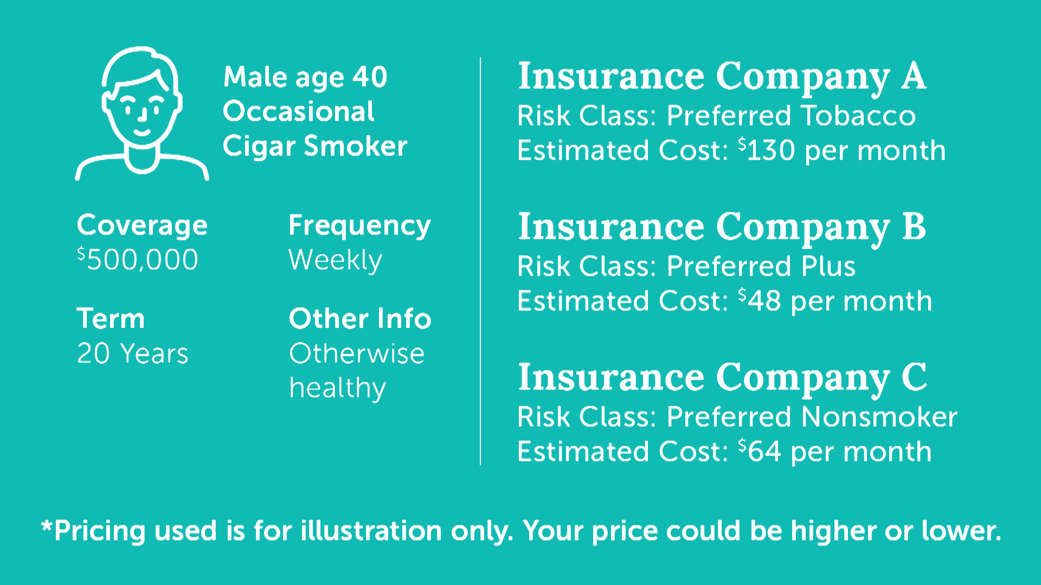

Slide 6
Problem statement
Haplift one of the largest issuers of life insurance in the USA is planning to improve its life insurance application process.
Our aim is to develop a predictive model that accurately classifies risk thereby making this process quicker and less labour intensive for new and existing customers to get a quote.
Our task is to predict the "Response" variable for each Id in the test set. "Response" is an ordinal measure of risk that has 8 levels.

Slide 7
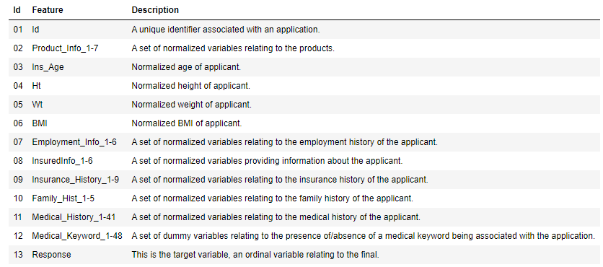
Description of the dataset

Slide 8
Pre-profiling
Dataset info:
Number of variables: 128
Number of observations: 59381
Missing cells: 393103(5.2%)
Duplicate rows: 0
Variables types:
Numeric = 24
Categorical = 56
Boolean = 48
13 columns have missing values
13 features are highly correlated.

Slide 9
Data Preprocessing
Dropping columns with more than 70% missing values:
Family_Hist_5, Medical_History_10, Medical_History_15, Medical_History_24, Medical_History_32.
Imputation of missing values of columns with median:
Employment_Info_1, Employment_Info_4, Insurance_History_5, Family_Hist_2, Family_Hist_3, Family_Hist_4, Medical_History_1.
Imputation of missing values in Employment_Info_6 with mean.
Converting categorical column Product_Info_2 into numerical form using Label Encoder.

Slide 10
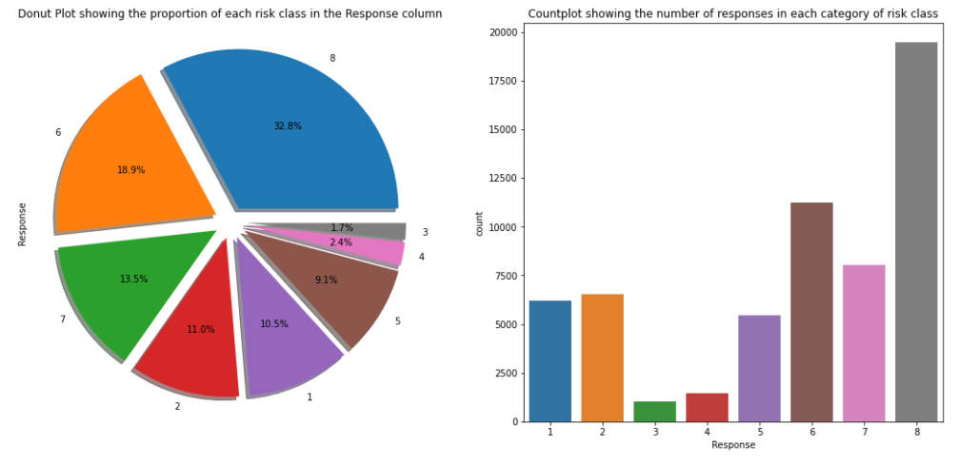
Data Preprocessing(cont.)
Converting target variable with multiple classes(1 to 8) to binary/two class(0 or 1).
Target variable(Response) before conversion contains 8 risk classes. Risk class 8 contains maximum number of responses.

Slide 11
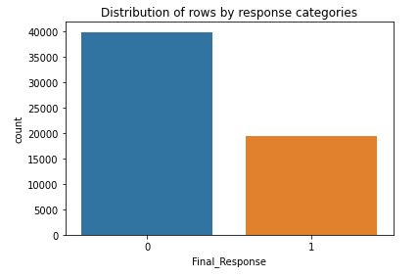
Data Preprocessing(cont.)
After conversion , the target variable contains two classes:
'Standard risk class': 1,
'Non-Standard risk class': 0.

Slide 12
Data Preprocessing(cont.)
The target variable now contains two class of customers, where:
1 will indicate the customer's life insurance policy belongs to the Standard risk class.
0 will indicate the customer's life insurance policy belongs to the Non-Standard risk class.
The new problem statement would be:
Based on the attributes of customers, will the life insurance policy belong to the Standard risk class or not i.e., yes(1) or no(0).

Slide 13
Post Profiling
Dataset info:
Number of variables: 122
Number of observations: 59381
Missing cells: 0
Duplicate rows: 33(0.1%)
Variables types:
Numeric = 18
Categorical = 55
Boolean = 49
Dropping Duplicate rows.

Slide 14
Exploratory Data Analysis
Analyzing Features and the Target Variable of the Dataset.

Slide 15
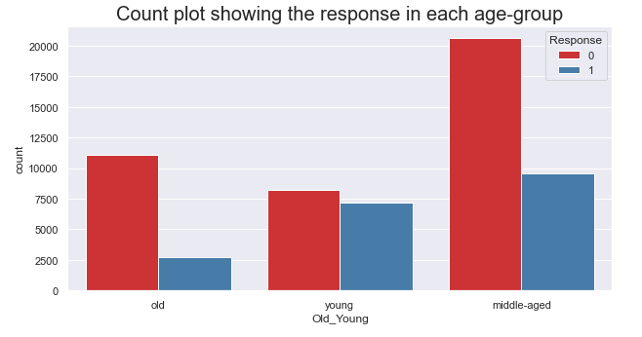
Distribution of Responses as per age-group of the applicants.
Majority of middle and old-aged applicants have been offered non-standard terms, so they might have to pay higher premiums.
Young applicants are almost equally offered standard as well as non-standard terms, so: Young applicants(fit and have no major disease) - lower premiums than standard.
Young applicants(fit but have ill-habits: drugs, smoking, drinking) - higher premiums than standard.

Slide 16
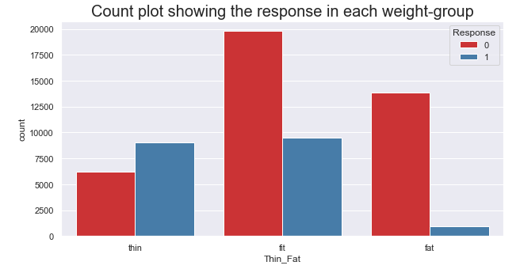
Distribution of Responses as per weight-group of the applicants.
Majority of applicants who are fit have been offered non-standard terms: paying lower premium, due to excellent health conditions .
Majority of applicants who are fat have been offered non- standard terms: paying higher premiums, due to the increased risk of health diseases associated with obesity.
Applicants who are thin are offered standard terms more as compared to non-standard terms.

Slide 17
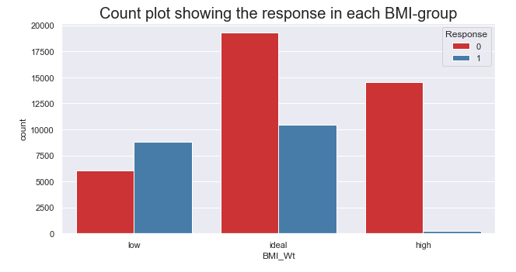
Distribution of Responses as per bmi-group of the applicants.
Majority of applicants having ideal BMI have been offered non-standard terms: paying lower premium.
Majority of applicants having high BMI have been offered non- standard terms: paying higher premiums.
Applicants having low BMI are offered standard terms more as compared to non-standard terms.

Slide 18
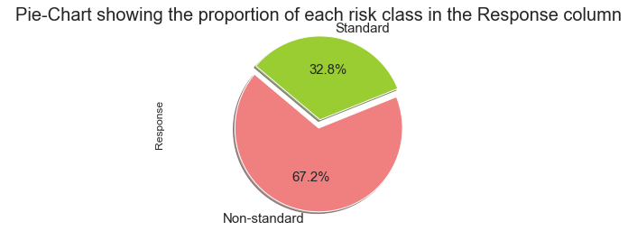
Analyzing Target Variable(Response)
Here, we can see that our target variable(Response) is imbalanced. This means that the percentage of people belonging to each risk class are not equal.
This indicates that we have an imbalanced dataset, so accuracy of the model will not determine the success of the model.
In case of imbalanced dataset, we rely on F1 score, Precision score, Recall score more than mere accuracy of the model.

Slide 19
Building Machine Learning Models
Using three Feature Selection Approaches

Slide 20
Basic Framework of Models
Applying Feature Selection Technique
Preparing X and y using pandas
Splitting X and y into training and testing datasets
Fitting models on X_train and y_train
Using models for prediction
Model Evaluation

Slide 21
Approach 1: Feature Selection using Pearson’s Correlation
This technique will give us a list of highly correlated independent features based on the threshold. We can later remove highly correlated features as they are serving the same purpose.
Threshold is set at 0.9, which means that features having correlation above 0.9 will be dropped before building the model.
Here, we have selected 113 features for our models.

Slide 22
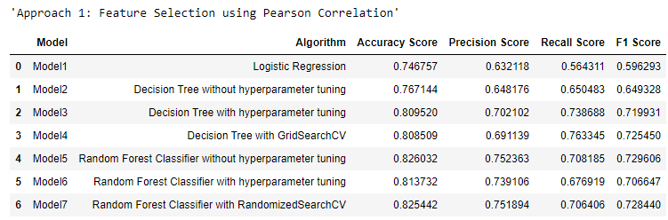
Results of models built with approach 1
Model5 using Random Forest Classifier without hyper parameter tuning, is giving the highest accuracy(82.60%) and F1 score(0.729606) as compared to the other models.
So, Model5 is selected.

Slide 23
Approach 2: Feature Selection using Mutual information
This technique is used when we have a discrete target variable having different classes or categories.
Mutual information (MI) between two random variables is a non-negative value, which measures the dependency between the variables. It is equal to zero if and only if two random variables are independent, and higher values mean higher dependency.
Here, we have selected top 50 features which have higher dependencies.

Slide 24
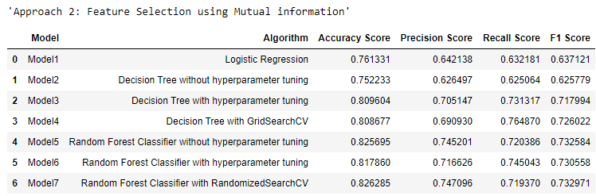
Results of models built with approach 2
Model7 using Random Forest Classifier with RandomizedSearchCV, is giving the highest accuracy(82.63%) and F1 score(0.732971) as compared to the other models.
So, Model7 is selected.

Slide 25
Approach3: Feature Selection using Feature Importance
In this technique we will use an in built feature of Random Forest Classifier called feature_importances_.
feature_importances_ will give us the most important features necessary to build our model successfully.
Here, we have selected top 20 features for our models.

Slide 26
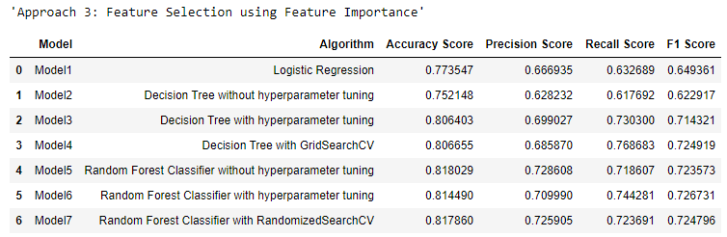
Results of models built with approach 3
Model5 using Random Forest Classifier without hyper parameter tuning, is giving the highest accuracy(81.80%). However, Model4 using Decision Tree with GridSearchCV is giving highest F1 score(0.724919) as compared to the other models.
So, Model4 is selected, because it has a higher F1 score as compared to Model5.

Slide 27
Conclusion of EDA
Majority of middle and old-aged applicants have been offered non-standard terms, so they might have to pay higher premiums.
Young applicants are almost equally offered standard as well as non-standard terms, so: Young applicants(fit and have no major disease) - lower premiums than standard.
Young applicants(fit but have ill-habits: drugs, smoking, drinking) - higher premiums than standard.
BMI is a much powerful predictor for determining the life insurance policy terms.
Majority of applicants who are fit(ideal BMI ) have been offered non-standard terms: paying lower premium, due to excellent health conditions and they are not likely to get morbid diseases in future.
Majority of applicants who are fat(high BMI) have been offered non-standard terms: paying higher premiums, due to the increased risk of health diseases associated with obesity.
On the other hand, applicants who are thin(low BMI) are offered standard terms more as compared to non-standard terms.

Slide 28
Conclusion of Machine Learning Models
According to the 1st approach: Feature Selection using Pearson Correlation, Model5 using Random Forest Classifier without hyper parameter tuning, is selected having the highest accuracy(82.60%) and F1 score(0.729606) as compared to the other models.
According to the 2nd approach: Feature Selection using Mutual information, Model7 using Random Forest Classifier with RandomizedSearchCV, is selected having the highest accuracy(82.63%) and F1 score(0.732971) as compared to the other models.
According to the 3rd approach: Feature Selection using Feature Importance, Model4 using Decision Tree with GridSearchCV is selected having highest F1 score(0.724919) as compared to the other models.

Slide 29
Actionable Insights
The company shall target the customers falling under the middle-age group(30-45 years), as they are more likely in the need of life insurance.
Middle age group customers are also more likely to buy life insurance for themselves, their children, and their parents.
In order to speed up the process of life insurance policy application, the company needs to collect more refined data from the customers with respect to their medical history, family history, family income, and term duration and other related information.
This will lead to better allocation of risk class thereby accurate and timely sending the quote for premiums corresponding to the risk class assigned to the applicant.
More advanced machine learning techniques can be applied to get better results.

Slide 30


